Slide 1
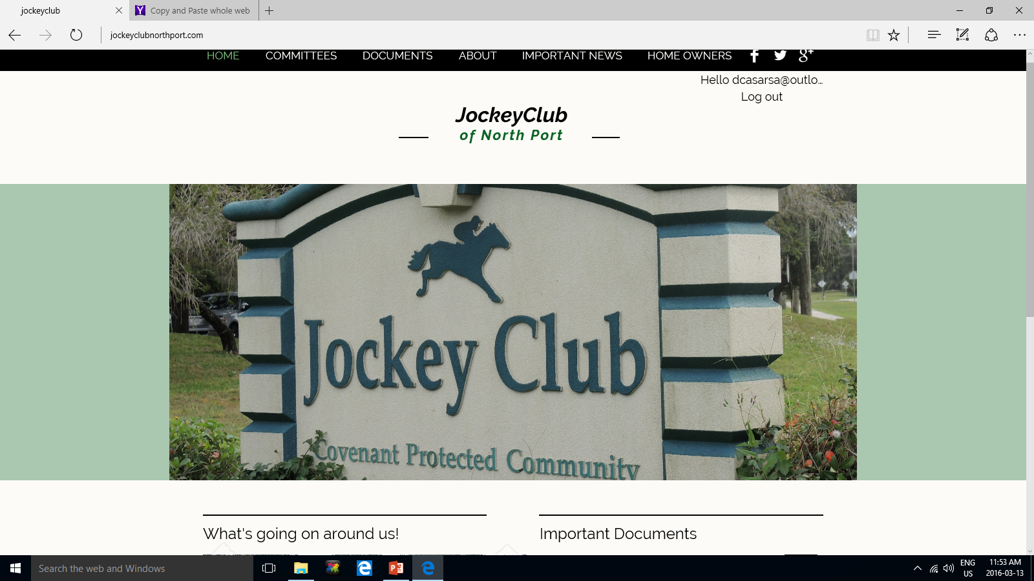
STRATEGIC PLAN REVIEW

Slide 2
Jockey Club Vision Statement
The Jockey Club of North Port, founded in 1979 and with 611 properties, is a deed restricted home owner's association run by volunteers. It has attracted professionals, young families, retirees and second home buyers. Over the years it was able to maintain a yearly low maintenance fee, offering the amenities of a multi-purpose clubhouse, a large heated swimming pool, a tennis and basket ball court, and several open areas. The association offers a unique combination of social and organizational meeting areas, recreation, support and community spirit within the City of North Port. The association strives to maintain and enhance the amenities and the values of the owner's properties.

Slide 3
JOCKEY CLUB STRATEGIC GOALS
Effective Governance
Financially Responsible
Community of choice within North Port
Member Oriented

Slide 4

EFFECTIVE GOVERNANCE
A proactive Board of Directors (BoD)
Self-reliant and self-governing
Programmed infrastructure improvements
BoD actively involved in Club operations, plans and expenditures
Increased use of media at meetings
  Projection capability, briefing notes, fact sheets
Decision taking based upon factual option analysis
Member focused
  Member participation in critical decisions
  Primacy of operations

Slide 5
FINANCIALLY RESPONSIBLE
Development of fiscal policies governing expenditures in near and long term to include responsibilities and levels of approval
Fiscally independent
Financial reserves at all levels
  Infrastructure funding
Maintain low HOA fees
Active and persistent pursuit of delinquent accounts
Income opportunities through facility rentals
Rigourous cost controls

Slide 6


A community of choice within North Port
1. Club Support
  Low HOA fees
  Clubhouse operations seven days a week
  Staged infrastructure programme for facility improvements
  Covenants that improve Jockey Club aesthetics and property values
    Fair and judicious enforcement
  Robust information campaign
    Website; Clarion newsletter; real estate; chamber of commerce, word of mouth
  Volunteerism
  Active Block Captains
2. Community Support
  Continued pro-active liaison with City of North Port
  Use of clubhouse as a rental facility
  Support to community activities
    church groups; Little Salt Spring
    Sarasota County Community Service Programme
  Support to members
    Internet access; photocopying; member contact list; website www.jockeyclubnorthport.com

Slide 7
Member Oriented
1. Grey Power (Seniors/Retirees)
  Seek skill sets/knowledge to support community operations/administration
    ie. Legal, finance, trades
  Continue with existing programs/activities.
  New programs/activities aimed at an older but more active generation
2. Family friendly
  Clubhouse activities aimed at children/youth
  Availability of clubhouse and amenities on weekdays and weekends
    Community dinners/dances/BBQs
  Increased representation on Board of Directors and committees
  Sport activities
    pool exercise/swimming lessons
    Tournaments
Recreation Programmes common to all

Slide 8
FOCUS FOR 2017
ACTIVE PURSUIT OF DELINQUENT ACCOUNTS
  Negotiation
  Liens
  Foreclosures
UPDATE OF BYLAWS AND COVENANTS
  2013 draft Bylaws as basis
ENFORCEMENT OF COVENANTS/RESTRICTIONS
  Active ECC operating with updated procedures
  Fining of non-compliant owners
  Update and Enforcement of Common Facility Rules
VOLUNTEERS
  Essential for member oriented activities/services
  Develops Community spirit

Slide 9
End State
A low cost, value oriented, independent, fiscally responsible Jockey Club that provides organizational and recreational services and opportunities to its members and is recognized as a community of choice within the City of North Port

