Slide 1
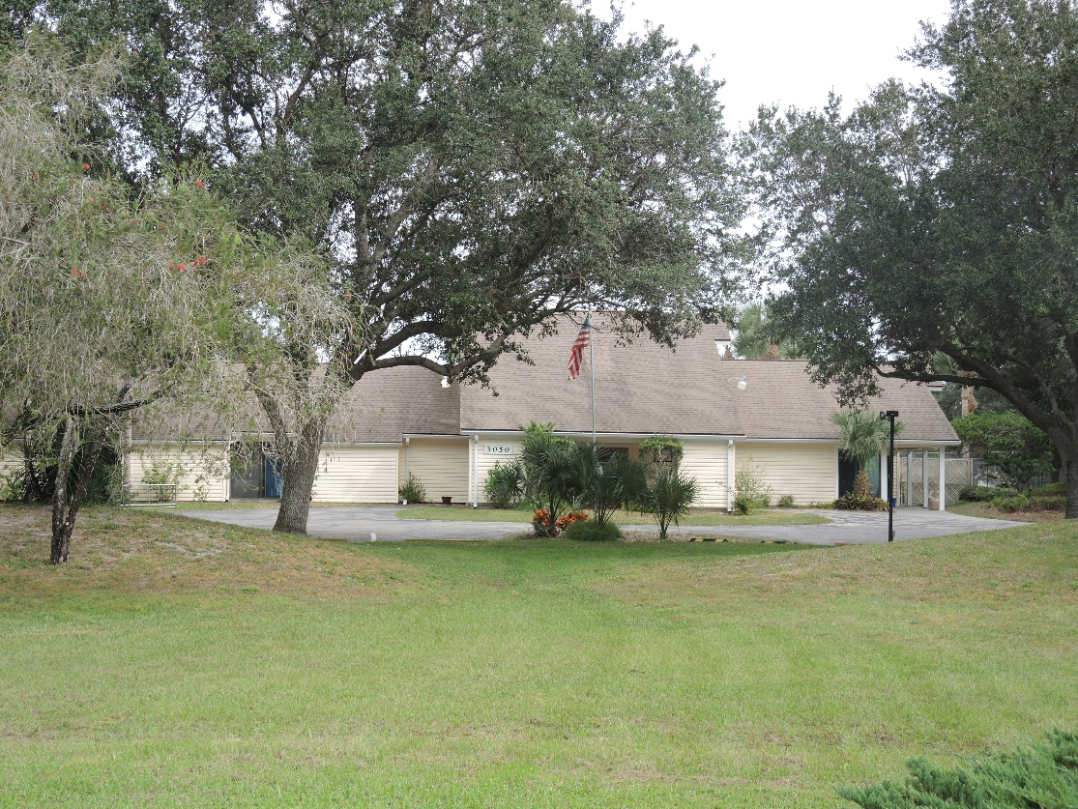
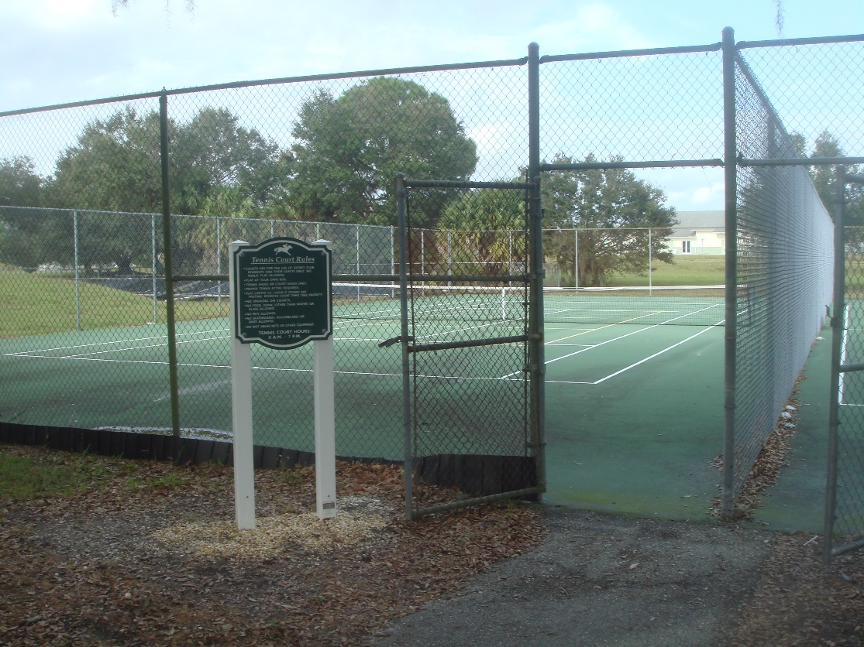
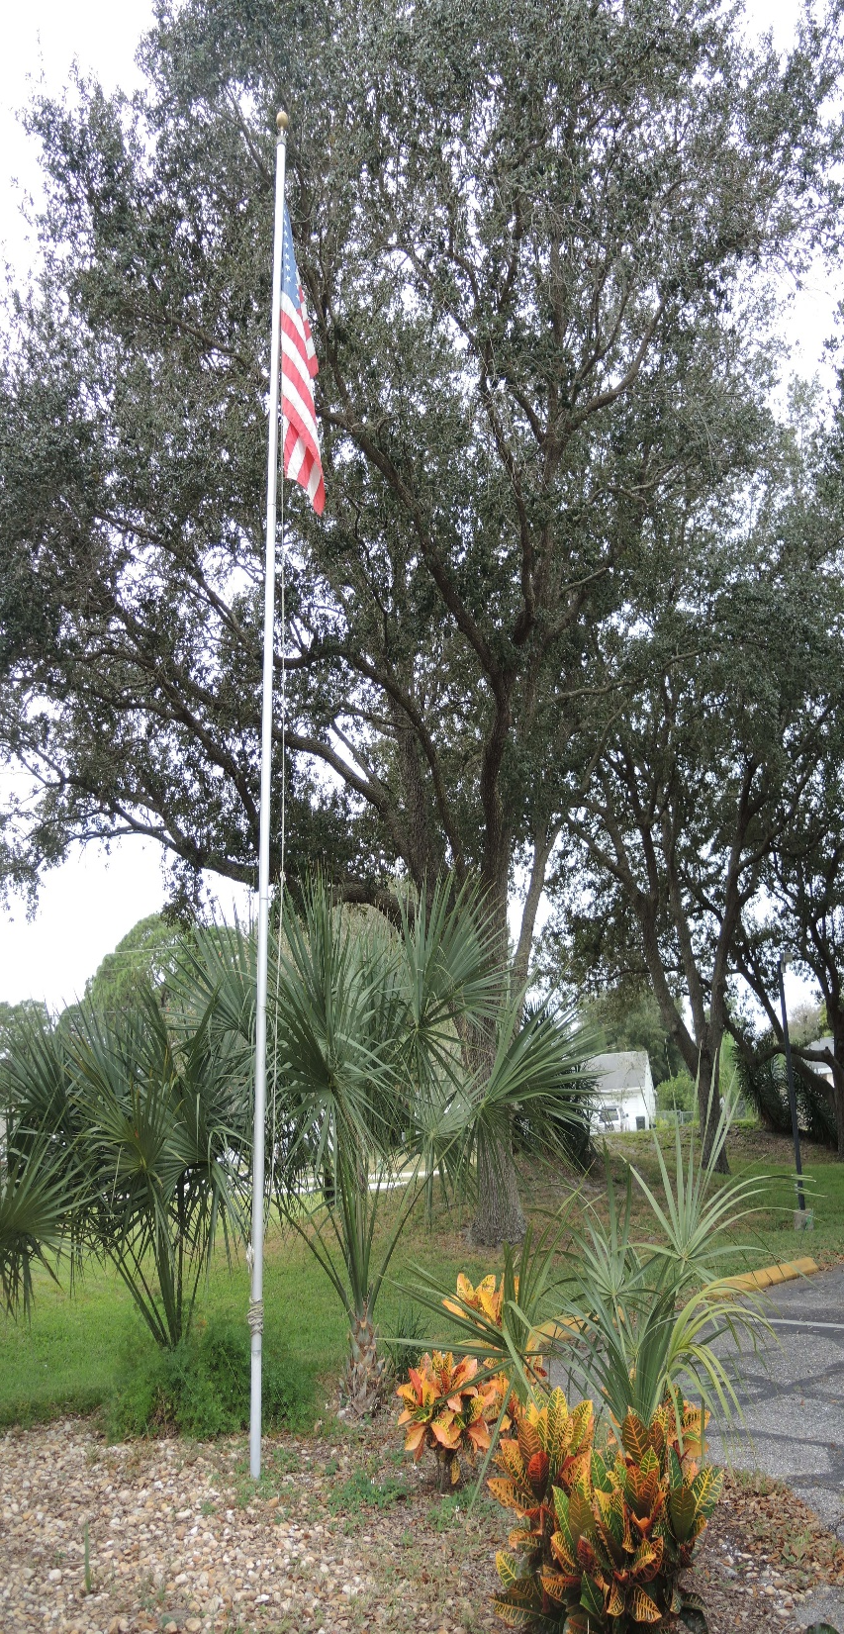
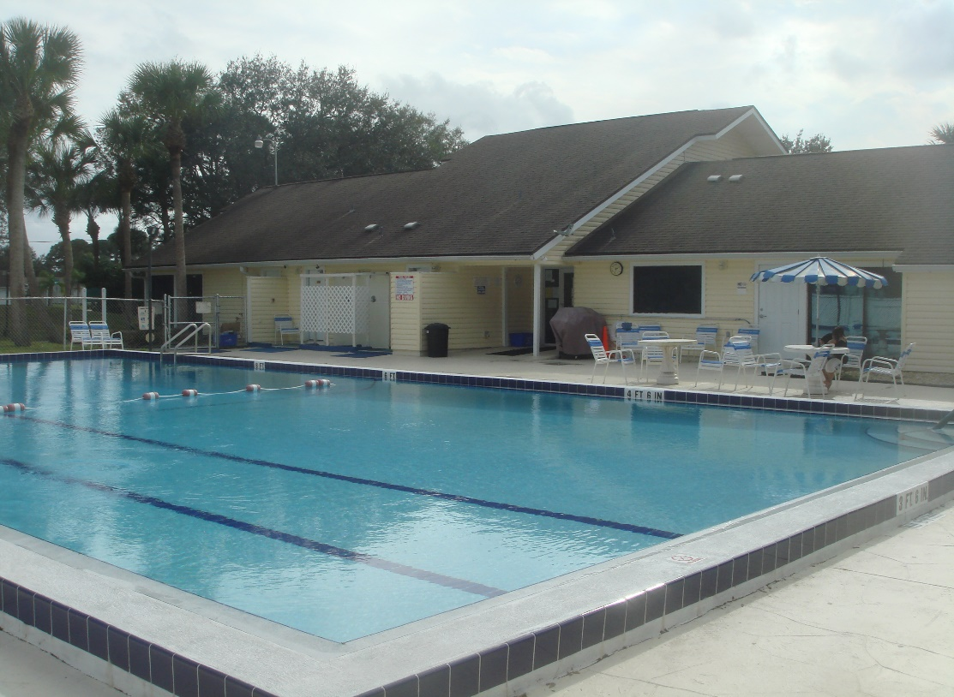
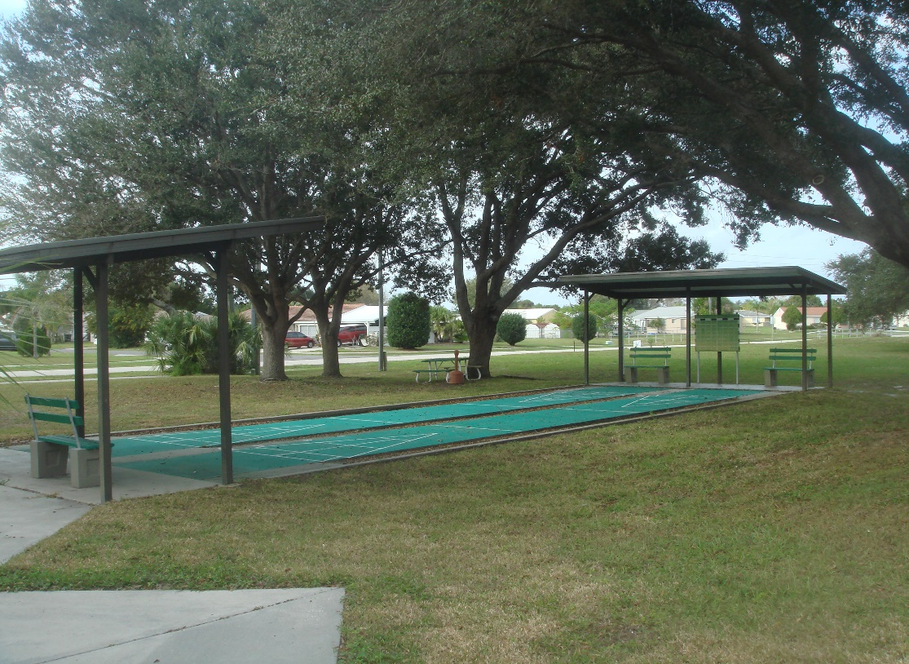
JOCKEY CLUB OF NORTH PORT POA INC ANNUAL GENERAL MEETING 14 MARCH 2019

Slide 2
AGENDA
1. Call the Meeting to Order - President.
2. Proof of Notice and Determination of a Quorum - President.
3. Approval of Minutes from the 2018 Annual Membership Meeting - President.
4. Acclamation/Call for Nominations - BOD
5. Annual Report - Officers and Committees - All.
6. Owner comments.
7. Adjournment.
Board of Directors Organizational Meeting immediately follows this meeting.

Slide 3
ACCLAMATION OF BOARD
Florida Statutes (FS) 720.306 - number of candidates is equal to or less than the number of vacancies, all candidates are hereby acclaimed to the Board of Directors. NO ELECTION
FS 720.306 9(c) – Elections. A board member appointed or elected under this section is appointed for the unexpired term of the seat being filled.
Allows assignment of term lengths IAW Bylaws - Art VII Sect 1.
Directors acclaimed:
Robert W Iiams (3 yrs)
David Casarsa (3 yrs)
Two Board Vacancies – call for nominations from the floor
Vacancy 1 – 3yrs
Vacancy 2 – 1 yr

Slide 4
ITEM 5 - JOCKEY CLUB ANNUAL REPORT
OPENING REMARKS – Bill Iiams
WHAT’S NEW
2019 PRIORITIES (no change from 2018)
ECC enforcement
Collections
Recognition of volunteers

Slide 5
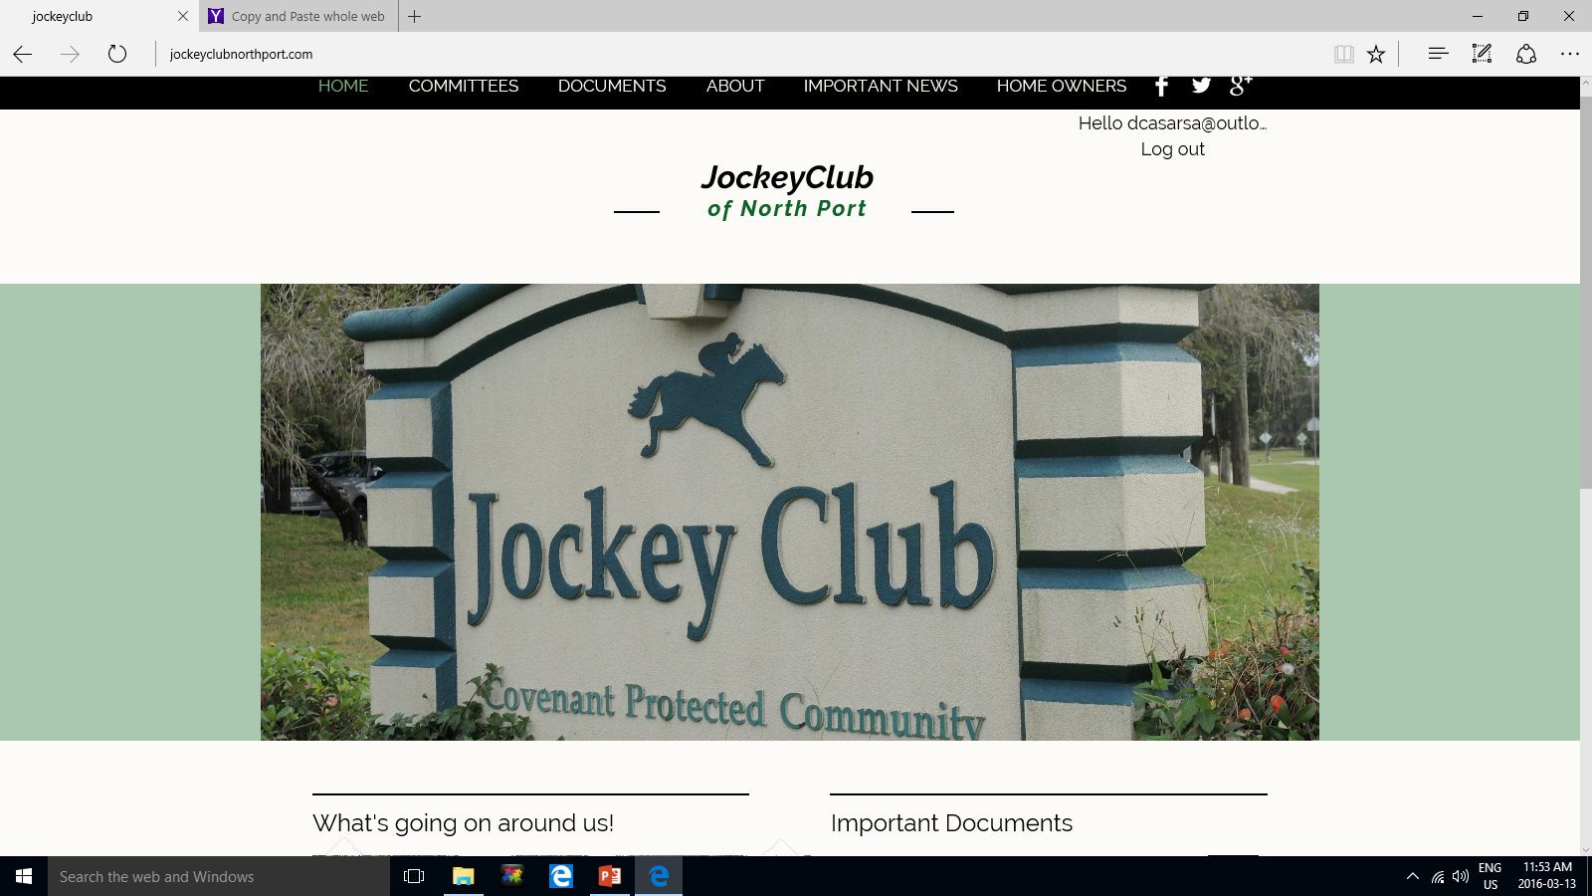
STRATEGIC PLAN REVIEW

Slide 6
JOCKEY CLUB STRATEGIC GOALS
Effective Governance
Financially Responsible
Community of choice within North Port
Member Oriented
Measures of Effectiveness - People
- Procedures
- Performance

Slide 7
EFFECTIVE GOVERNANCE
A proactive Board of Directors (BoD)
Self-reliant and self-governing
Programmed infrastructure improvements
BoD actively involved in Club operations, plans and expenditures
Increased use of media at meetings
Projection capability, briefing notes, fact sheets
Decision taking based upon factual option analysis
Member focused
Member participation in critical decisions
Primacy of operations

Slide 8
FINANCIALLY RESPONSIBLE
Development of fiscal policies governing expenditures in near and long term to include responsibilities and levels of approval
Fiscally independent
Financial reserves at all levels
Infrastructure funding
Maintain low HOA fees
Active and persistent pursuit of delinquent accounts
Income opportunities through facility rentals
Rigourous cost controls

Slide 9
A community of choice within North Port
1. Club Support
Low HOA fees
Clubhouse operations seven days a week
Staged infrastructure programme for facility improvements
Covenants that improve Jockey Club aesthetics and property values
Fair and judicious enforcement
Robust information campaign
Website; Clarion newsletter; Facebook Page; real estate; chamber of commerce, word of mouth
Volunteerism
Active Block Captains
2. Community Support
Continued pro-active liaison with City of North Port
Use of clubhouse as a rental facility
Support to community activities
church groups;
Sarasota County Community Service Programme
Support to members
photocopying; member contact list;
website www.jockeyclubnorthport.com;
Facebook https://www.facebook.com/thejockeyclubofnorthport/

Slide 10
Member Oriented
1. Grey Power (Seniors/Retirees)
Seek skill sets/knowledge to support community operations/administration
ie. Legal, finance, trades
Continue with existing programs/activities.
New programs/activities aimed at an older but more active generation
2. Family friendly
Clubhouse activities aimed at children/youth
Availability of clubhouse and amenities on weekdays and weekends
Community dinners/dances/BBQs
Increased representation on Board of Directors and committees
Sport activities
pool exercise/swimming lessons
Tournaments
Recreation Programmes common to all

Slide 11
FOCUS FOR 2019
CONTINUED ENFORCEMENT OF COVENANTS/RESTRICTIONS
Active ECC operating with updated procedures
Fining of non-compliant owners
Enforcement of Governing Documents and Common Facility Rules
CONTINUED EMPHASIS ON COLLECTION ACTIVITY
Pursuit of delinquent accounts
Foreclosure of oldest delinquent accounts
Seek new legal counsel
VOLUNTEERS
Essential for member oriented activities/services - Committees
Maintenance of Club facilities
Develops Community spirit
A lack of volunteers will lead
to increased costs in the future

Slide 12
COMMITTEE MEMBER REPORTS

Slide 13
COLLECTIONS
David Casarsa

Slide 14
2018 COLLECTIONS
27 accounts overdue at end Feb 19 ~ $50.000.00
Equals 4.4% of membership. Of that:
8 accounts = payment plans/settlement agreements ~ $15,500.00 to be recovered within 1-2 yrs.
3 accounts (possibly 4) likely uncollectable ~$12,000.00
1 account – Foreclosure trial ~ $8,000.00
16 accounts – Claims of Lien filed ~$14,500.00
5 x Candidates for foreclosure action in 2019
Three foreclosures settled in 2018. One foreclosure trial in May 19.
Legal activity = $16,200.00.
Legal fees recovered = $6,220.00
Assessments recovered = $10,516.00

Slide 15
2019 ACCOUNT STATUS
As of 12 March 2019, 148 accounts remain unpaid
Includes the 16 accounts carried over from 2018
Equates to 24.2% of membership
Total amount owing = $35520.00
Total collectible from assessments= $148,900.00
Leniency and understanding has a price – do you wish to pay for it?
Deficiency = $58.00 assessment increase per household.
Collection activity re-commences end Mar 2019

Slide 16
WOODS LANE
David Casarsa

Slide 17
WOODS LANE ACCESS
Owned by 417 LLC. City of NP has right of way. Existing road.
Owner obtained court settlement to quiet title in Feb 19
Jockey Club was sued but did not contest.
Jockey Club has no ownership or financial interest in property.
City of NP claims to have a solid case to contest issue if owner tries to close or renegotiate Woods Lane access.
City of NP expected to react to any further action by 417 LLC

Slide 18
WOODS LANE – ALTERNATE ROUTE
Options to be presented to City Commissioners by DPW at 4pm 23 April 2019.
Jockey Club needs support from membership to attend and voice support.
OPTIONS under consideration:
Spring Haven – Vestridge Extension
Jockey Club Emergency Route
Connect SHENENDOAH – ROSLYN Ct – unlikely
Connect VCP via SHENENDOAH or RYECROFT – least likely – no VCP support

Slide 19
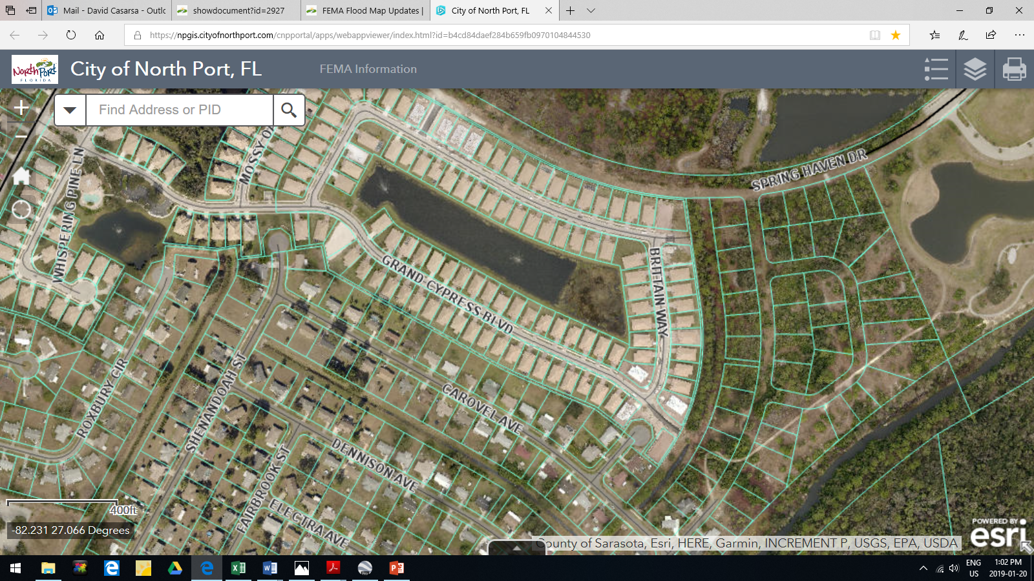
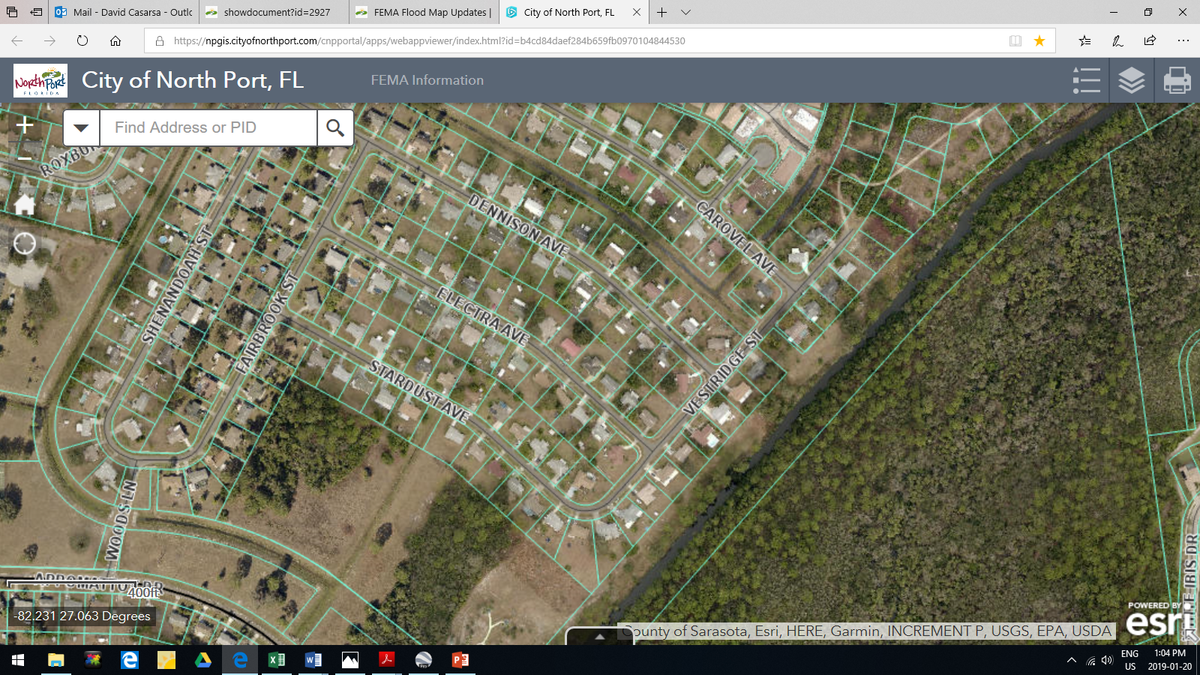
Spring Haven Dr
Villas of Charleston Park HOA
Vestridge Street
“The Island”
Woods Ln
Ref: City Interactive Map Application
https://npgis.cityofnorthport.com/

Slide 20
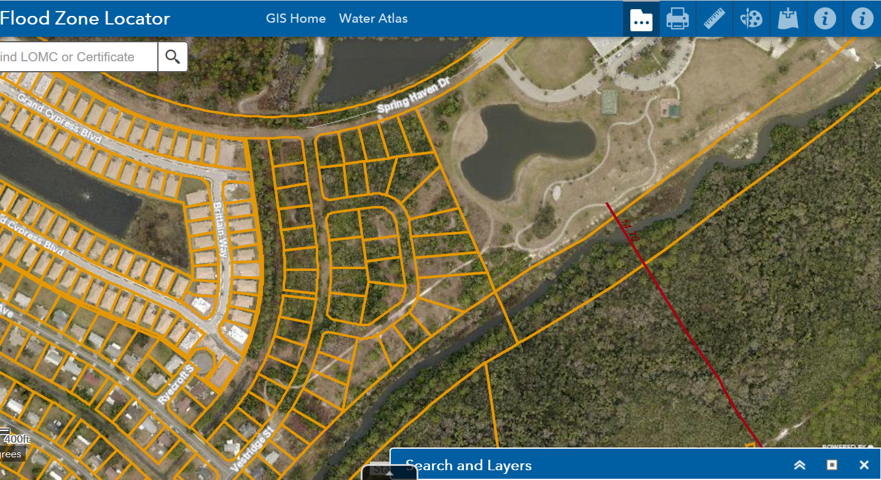
Spring Haven Drive
Gate 1
Gate/
Veh barrier
Vestridge Street
JOCKY CLUB Proposed Route – Vestridge Extension
Ref: https://ags3.scgov.net/sarcoflood
Gate 2

Slide 21
Secretary's Annual Report
Staff is striving for
Accuracy and Professionalism

Slide 22
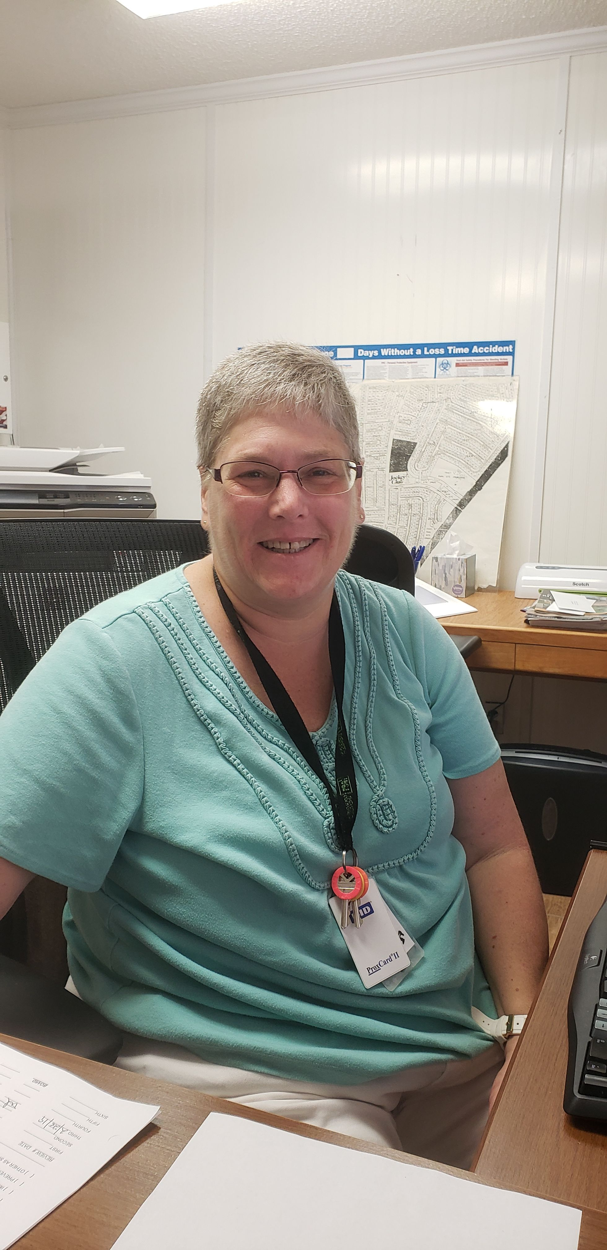

Slide 23
Staff member | Primary Duties | Secondary
Jenny | Financials including payroll and Estoppels | Customer Service
Ruth Ann | Customer Service | ECC Letters, Homeowner Books,
Judy | Customer Service | Back-up Jenny with Financials

Slide 24
ECC
PAUL DYSON

Slide 25
ENVIRONMENTAL CONTRLOL
2019 GOAL – Maintain property values
In 2018, increased support from homeowners in maintaining their properties
Use Property Tip Sheets to report infractions. ECC will investigate.
Keep ECC and your neighbors happy:
Cut your lawns
Clear your swales
Remove mold from your homes

Slide 26
ECC ACHIEVEMENTS - 2018
Bi-weekly inspections of all Jockey Club homes
First Violation Letter – 462 sent
Second Violation Letter – 100 sent
Third Violation Letter – 25 sent
98% Compliance after third letter
Referrals to Board for Fining – 8
Fined by Board/Supported by Fining Committee - 3

Slide 27
MAINTENANCE
BILL SEAVER

Slide 28
MAINTENANCE PROJECTS 2018
REPAIR
REPLACEMENT
CLEANING
NEW PURCHASES/ADDITIONS

Slide 29
CITY LIAISON
BILL IIAMS

Slide 30
Recreation
We love to gather with our neighbors!

Slide 31
Hurricane Awareness
Photos removed due to file size

Slide 32
Trunk or Treat
Photos removed due to file size

Slide 33
Photos removed due to file size
Annual Christmas Party

Slide 34
Hall Rentals
Photos removed due to file size

Slide 35
Won’t you join us?
Come out and be a part of the fun at the Jockey Club!

Slide 36
WELCOMING
LISA MOORE
73 WELCOME PACKAGES DELIVERED TO NEW HOMEOWNERS

Slide 37
Jockey Club of North Port Financial Report
Notes:
The Mission Statement speaks of attracting professionals, young families, retirees and second home owners.
It strives to maintain and enhance the amenities and the values of the owner properties.

Slide 38
JOCKEY CLUB’S CAPITAL INVESTMENTS
2016 2017 2018
20,000 94,000 19,875
Notes:
In the first year, 2015, we struggled with repairs and minor replacements.
For the first time, in 2016, planned expenditures were executed, with additional H and repairs to the pool filtering system.
However, early in 2017, we had to handle a major unplanned expenditure – the replacement of the hall ceiling and lights, at a cost of $40,000.
Later in the year, we followed through with the planned installation of
parking lot with a new surface and a gate
pool heating pumps and new fence
placement of a computer network and efficient software
covering the legal expenses for the Bylaw replacement

Slide 39
JOCKEY CLUB’S YEAR END CASH POSITION
2015 – $ 61,000
2016 – 73,589
2017 – (12/31) 38,574
2018 – (12/31) 79,945
Notes:
2014 Cash on hand: $44,093.
Reviewing these yearly results and speaking conservatively, it indicates that there is a tendency to have funds left at the conclusion of the year.
By including the $40,000 for the unplanned expenditures, we end up in 2017 with a similar cash level as we show in the previous year.

Slide 40
JOCKEY CLUB’S RESERVES
2015 - $ 32,522
2016 - 103,035
2017 - (12/31) 102,658
2018 – (12/31) 71,133
Notes:
2014 Reserves came to $18,643.
Efforts were started in early 2015 to place more funds into the reserves. With increased collection of owed funds and staying frugal, we were able to accumulate more than $100,000 in the reserves in the following year. With that, we established a 5 year capital investment plan, covering anticipated projects.
In the last year, despite taking care of planned and unplanned major projects, we still were able to again to put aside more than $100,000 for the reserves

Slide 41
JOCKEY CLUB’S TOTAL ASSETS
2016 2017 2018
$178,764 141,441 151,078
Notes:
Total Assets: Reflects the funds that are in the bank accounts and the reserves.
Total Assets in 2014 came to $77,459.
Budget: Board approved anticipated income and expenditures for the year 2018.
From the start in 2015, we looked out for preserving funds and still fulfill every needs. That year we determined the offices needed to be restructured and the front office should be open also on weekends.
In 2016, we were able to put aside more than $100,000 in reserve funds, with an additional ca. $70,000 in cash sitting in the banks.
In 2017, we would have achieved similar results had we not to face an unplanned major expenditure – the hall ceiling cost of $40,000.
In coming years, we can not expect similar savings as our unusual cash inflow from the collection side will dry up.

Slide 42
JOCKEY CLUB’S AGED RECEIVABLES
2016 2017 2018
$ 39,508 10,499 14860
Cases: 18 4 (6) 5
Notes:
2014 Aged Receivables: $78,245 with ca.100 collection cases and all in all 195 owners owed us funds.
Major collection cases dropped to 42 in 2015. Serious cases amounted to ca. 30 which owed half of all outstanding receivables. Over the last 2 years these old cases have substantially dwindled where we can report that today all cases are approaching resolution. Four cases are left that are adjudicated and in two cases the owners have agreed to settle resulting in monthly payments.

Slide 43
BONUS INCOME 2018
INCOME
2018 BUDGET
Hall Rentals - $10,000 0
Estoppels - $ 7,800 $4,000
Interest - $ 4,745 0
Misc Income - $ 3,870 0

Slide 44
WHAT LIES AHEAD
Training of personnel in use of QuickBooks
Transfer of multiple spreadsheet data to QuickBooks
Continue to Resolve Aged Receivables
Keep the Assessment at $ 240
Notes:
All office personnel need to accomplish the handling the front office tasks and familiarize themselves with all treasury programs.
With the settlement of the old cases, we will be able to concentrate on new cases that have been identified as collection items.
It is anticipated, with more owners 2018 payments received that sufficient reserve funds will enable us to replace the club house roof this fall.
At this time, there is no pressure to increase the annual maintenance assessment.
Property values have, in general, gone up by more than 15%. With renewed and greater attention to the well being of the community, it is anticipated that is will have a positive effect on property values. But please, this only can happen with increased owner participation.

Slide 45
WHAT DO I GET FOR MY $240.00 A YEAR?
Full use of the Clubhouse and amenities (meeting room, pool, courts)
Preferred rates when renting Great Room/kitchen for functions
Free notary public services – courtesy Jen Iiams
Free use of the Clubhouse Library
Free Annual Christmas Party
Low cost dinners – courtesy Rec Committee
Current, clear and enforceable property standards to enhance value
Infrastructure improvements to Clubhouse:
Heat pumps, pool filtration, perimeter fence, parking lot/gates, roof

Slide 46
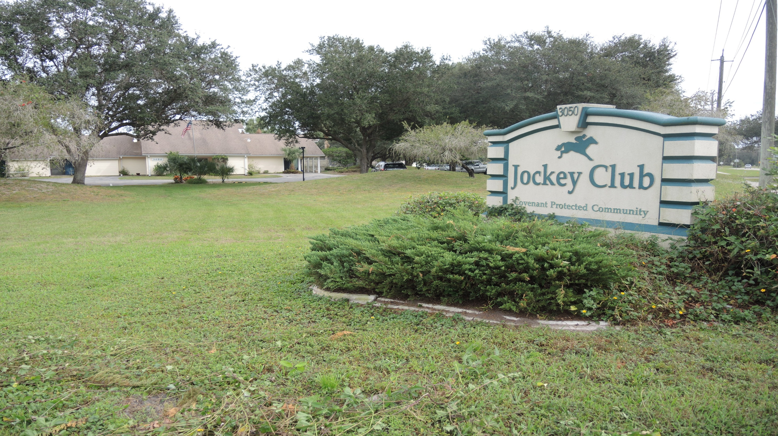
ITEM 6 - OWNER COMMENTS

Slide 47
ITEM 7 - ADJOURNMENT

