Slide 1
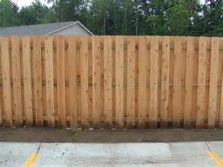
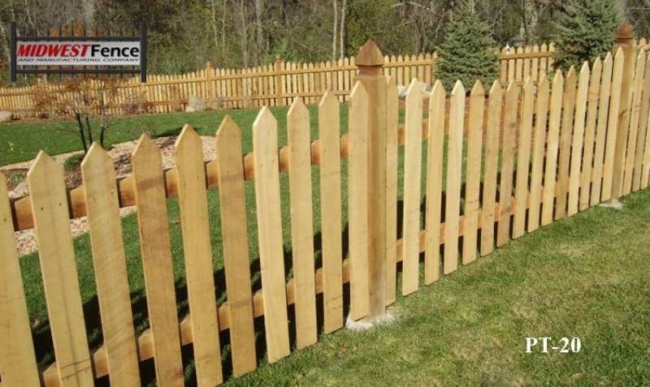
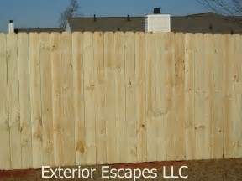
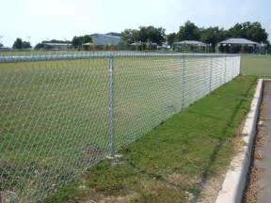
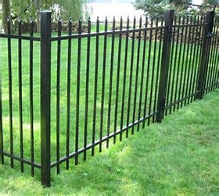
Jockey Club of North Port POA Inc
2018 Declarations of Covenants and Restrictions (DRAFT)
Proposed Fence Types
Ref: Declarations of Covenants
And Restrictions (DRAFT)
Art IX, Sect 12
Max Height = 6 ft
Material = Wood/PVC/Vinyl
Colors = Wood – natural
= PVC/Vinyl - white
Board on Board
Picket
Stockade
Max Height = 4 ft
Material = Galvanized, Vinyl Coating
Colors = natural galvanized
= vinyl coating – white or black
Max Height = 6 ft
Material = Iron/Steel/Aluminum
Colors = white or black
Chain Link
Ornamental

